Slide 1
Gas Laws
Complete By | TOPIC | PRACTICE
Section 1 Complete as Apr 28 homework | KMT Theory
Section 2 | Charles’ Law Volume vs Temperature | Questions on linked sheet Charles': pg 434 #16-19
Work on Section 2 May 5- 9 | Boyle’s Law Pressure vs Volume | Questions on linked sheet Boyle's: pg428 #5-8
 | Pressure vs Temperature (Gay Lussac’s)
Section 3 May 12 - 16 | Combined Gas Law Section 3 Assignment - See slide for info | Questions at bottom of the Combined Note note
Section 4 May 20-23th | Ideal Gas Law PV=nRT | text reference p. 443-445
 | Gases Textbook Solutions | Investigating Gas Laws - Virtual lab Atmospheric Gases and Health

Slide 2
In Class Gas Days -
Day | TOPIC | PRACTICE
Jun 6 & 9 (dates are approximate) | Ideal Gas law and Partial Pressure wrap up In class day to solidify your understanding of the Day 1-4 concepts and complete additional practice questions. Focus on partial pressures and ideal gas law Please bring all materials to utilize your time well. Practice on Partial Pressures. Answers are at the bottom | Dalton partial pressure slides Khan Partial Pressure
Jun 10 | QUEST on Sections 1-3 (this will count as a small mark on final grade) After Quest: Read p 466 - 468 on combining volumes
Jun 11 | Molar Volume and Combining volumes Molar Volume Note & Slides Molar Volume Of Gas | Chemical Calculations | Chemistry | FuseSchool Molar Volume of a Gas Lab DEMO (or Video version) (Also read text p. 469-471) Law of combining volumes (Last page of ideal gas law note, AKA Gay-Lussac’s Law) | Read p 466 - 468 on combining volumes p. 471 #7-11 p. 472 #12-14 p. 474 #1-3

Slide 3
In Class Gas Days -
Day | TOPIC | PRACTICE
Jun 12 | Value of R Lab (Class Set Handouts) Value of R lab Instructions & Image | Read stoichiometry portion of ideal law note (posted above) for next class p. 468 #1-5 finish calculations from lab
Jun 13 | Gas Stoichiometry Read end of ideal gas law sheet and work on questions for homework. Gas Law Stoichiometry Worksheet Practice.pdf - Answers Note that the answer sheet uses a different problem solving method but you should be able to match your calculation and certainly see if you get the correct answer. | p. 483 #1-4 p. 486 #1-4
Teacher Note for next time: The old STP values are given in Ideal and combined gas notes and in some of the questions if its possible to modify - S25 we decided NOT to modify, too hard with most resources using old STP

Slide 4
IMPORTANT NOTES
Gas Laws Summary
SCH3U Terms & Translations
The above summary is great. A few notes though:
We will mostly use the value of R of:
8.31 L•kPa•mol-1•K-1 . THis R value is in kPa which is why the number is different.
ALSO: the current international Standards are different than your textbook and some of the notes here. However, we will use the same as your textbook:
STP: 0C (273K) and P = 101.3 kPa
SATP: 25C (298K) and P = 100kPa

Slide 5
Read Kinetic molecular theory p109-110 and
p419-420. Make own notes on it.
KMT Part 1 Video
KMT Part 2 Video
Absolute zero video
Gas Particles Note & Questions is another optional reading & practice
Introduction & KMT

Slide 6
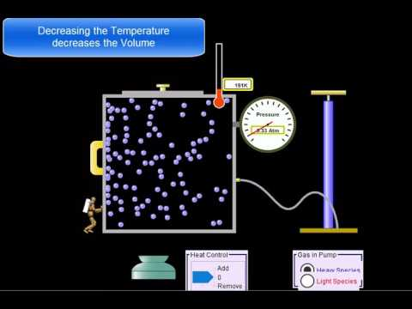
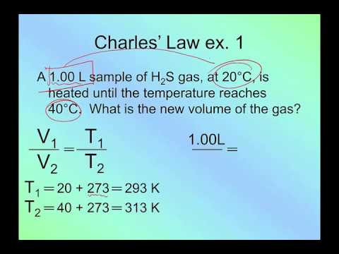
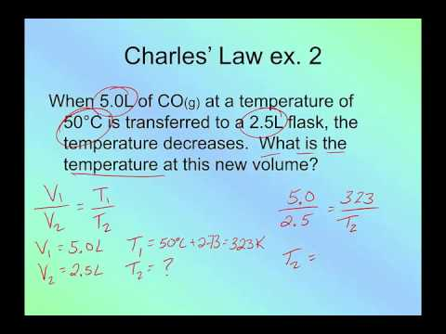
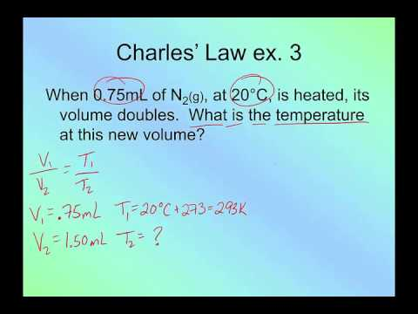
Volume vs Temperature
Temperature and Volume of Gases Sheet Video on Charles Law

Slide 7
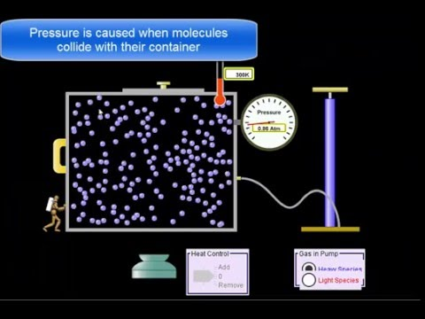
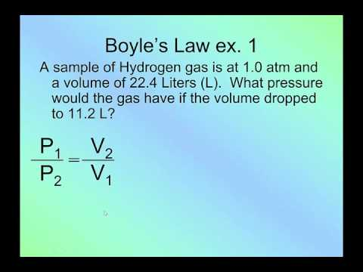
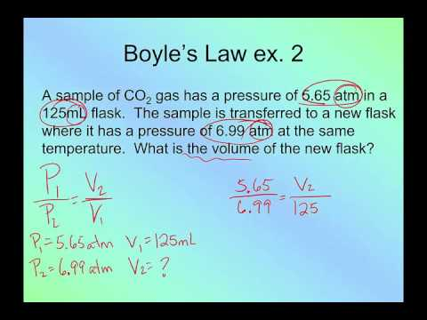
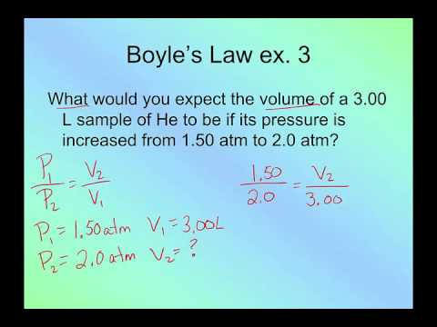
Pressure vs. Volume
Continued Next Slide

Slide 8
Pressure and Volume of Gases Sheet
Gas Pressure Basics Video
Pressure Conversions Video
Pressure Animation
Boyle's Law Video
Pressure vs. Volume

Slide 9
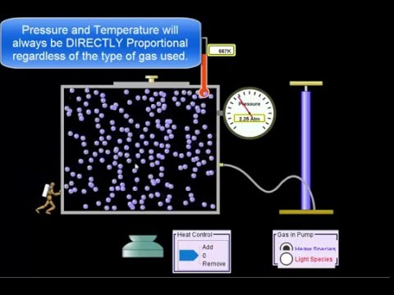
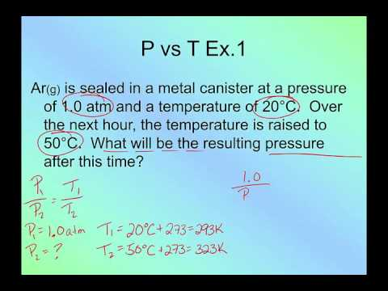
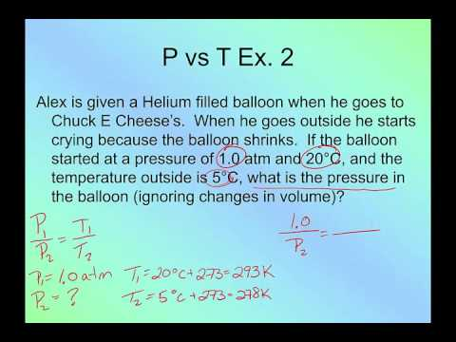
Pressure vs Temperature
Self-Check Quiz Answers

Slide 10
Combined Gas Law
** FYI Some online materials may use different STP values & you may see different numbers in university depending on your program.
(Try to fill in the blanks by yourself, for help see following video)
Rearranging the Combined Gas Law Video
Optional Helpful Video:
Choosing the RIGHT Gas Equation
Combined Gas law
Section 3 Assignment: SUBMIT Questions #5-7 from The Combined Note. FULL solutions must be clearly shown.

Slide 11
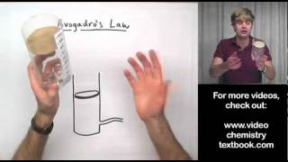
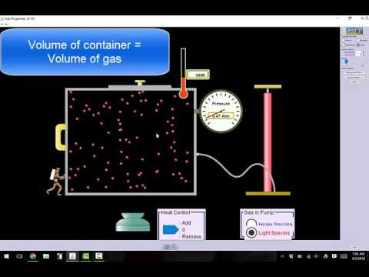
Avogadro’s Hypothesis
Avogadro's law states that "equal volumes of all gases, at the same temperature and pressure, have the same number of molecules."
Ideal Gas Law Note
Introduction & PV=nRT
Continue to next slide for examples

Slide 12
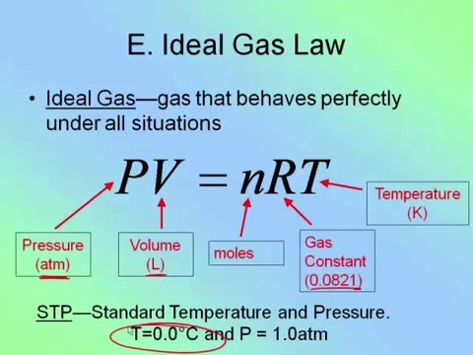
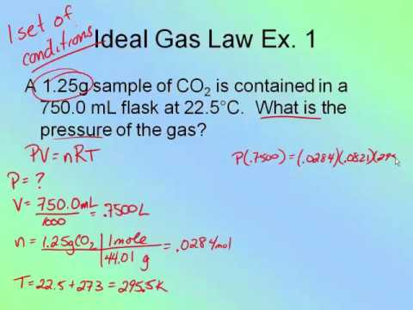
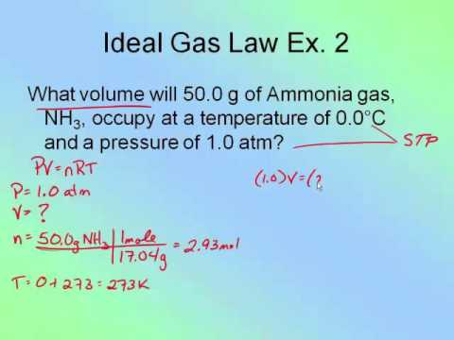
PV=nRT
NOTE ON VALUE OF R: Most of our questions will use 8.31 L•kPa•mol-1
•K-1 . The numerical value of R can be different if the units, especially for pressur ar different
Introduction & PV=nRT

Slide 13
Ideal Gas Law Problems Video
Converting between mole & volume at STP
How to avoid memorizing ALL the gas laws
VideoChoosing the RIGHT Gas Equation
EXTRA HELPFUL ITEMS

